Slide 1
Abschlussarbeit: Deep Learning zur Bildbeschreibung

Slide 2

About Me
Muralidhar Pettela
Masters student in University Rostock
ELEKTRONISCHE FAHRWERKSYSTEME
Writing master thesis from april- september 2018
Topic: Deep learning image classification in a productive data management environment

Slide 3
Agenda
01
Abstract
02
Goals of the project
03
Data visualization
04
Transfer learning
05
Tools used in project

Slide 4



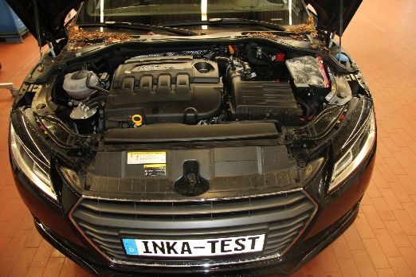
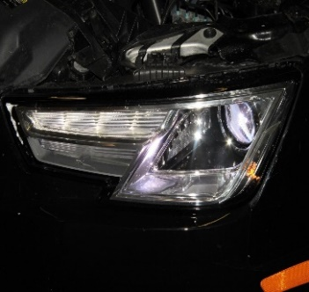
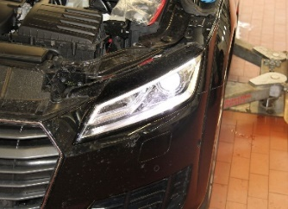
What is image classification?
3
Frontend
motorraum
Blinker
Blinker
Elektrik
Frontend
motorraum
A Pool of 100.000 images
Elektrik
2
1
Actual Process: Manual sorting of car parts
12.07.2018
EFS-Präsentationsvorlage
4

Slide 5
What is image classification?
3
Frontend
motorraum
Blinker
Blinker
Elektrik
Frontend
motorraum
A Pool of 100.000 images
Elektrik
Inputs
2
Outputs
Deep Neural Network,which acts an artifical human brain.
1
12.07.2018
EFS-Präsentationsvorlage
5

Slide 6
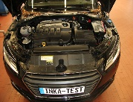
Goals of the project
Designing a efficient ConvNet to correctly classify the images from COKO(Audi) database.
Training the network for the best accuracy
Hyperparameter tuning
Evaluation & testing
Output
Frontend_Motoraum
Conv1
Conv2
Conv3
1
0
Input
Output Layer
Pool2
Pool3
Fully
Connected Layer
Pool1
Feature Extractor
Classifier

Slide 7
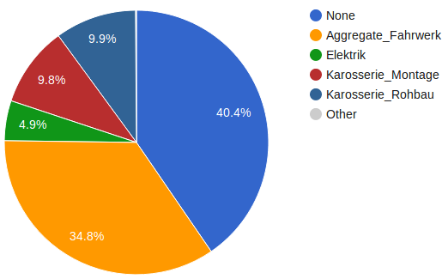
Data visualization
Main categories
Elektrik
Aggregate_Fahrwerk
Karosserie_Rohbau
Karosserie_Montage
Under each main category, we have a sub categories.
Link:
file:///C:/Users/pettm/Desktop/sample.html

Slide 8

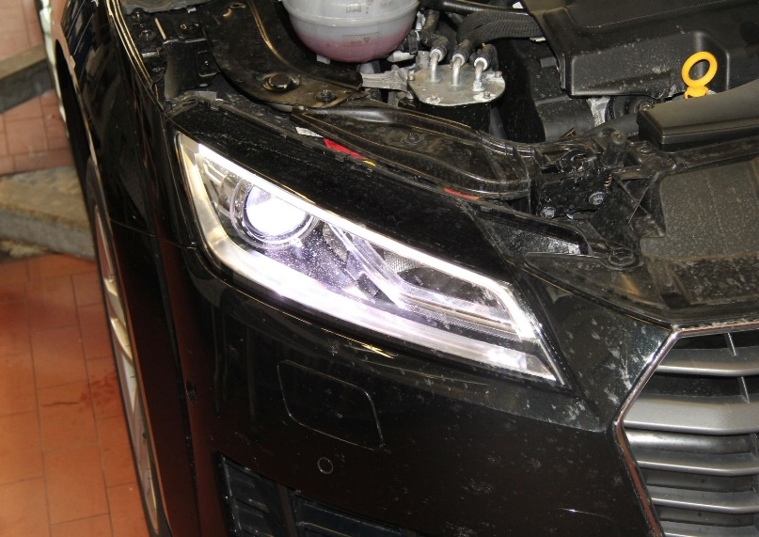
Sample data
Elektrik_Frontend_Motoraum

Slide 9
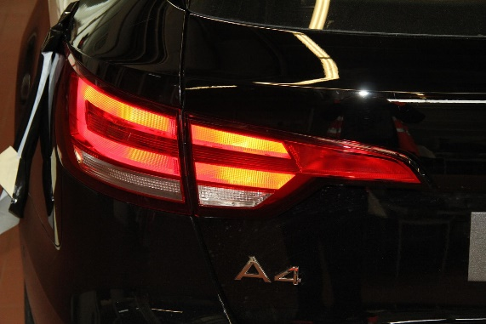
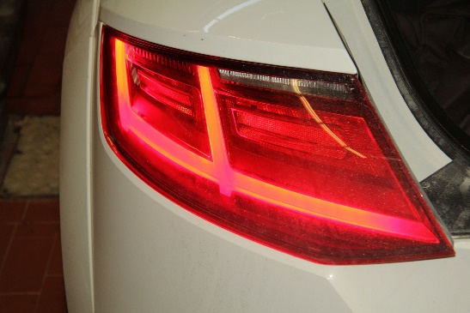
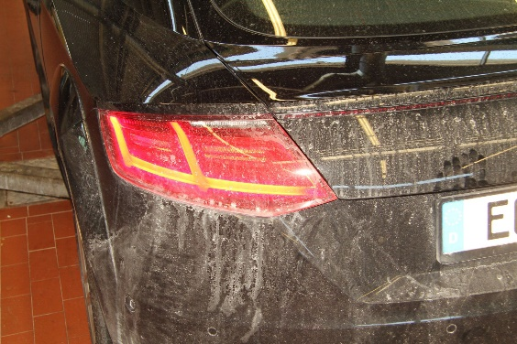
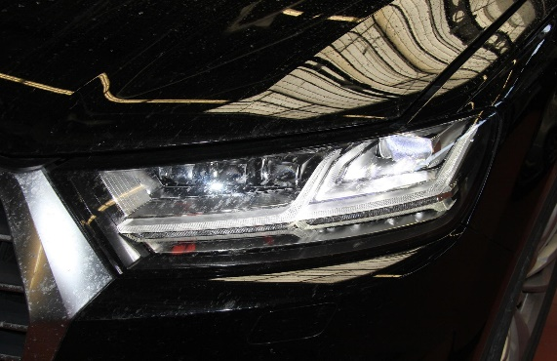
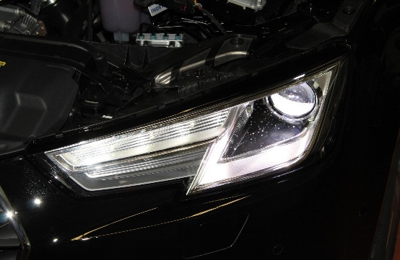
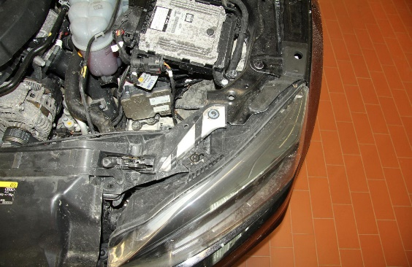
Sample data
Elektrik_Heckleuchten_Bremsleuchte
Elektrik_Scheinwerfer_Blinker

Slide 10
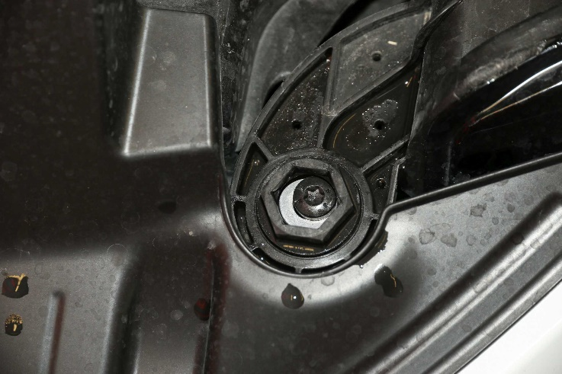
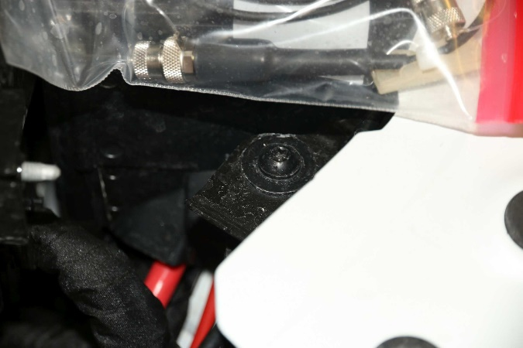
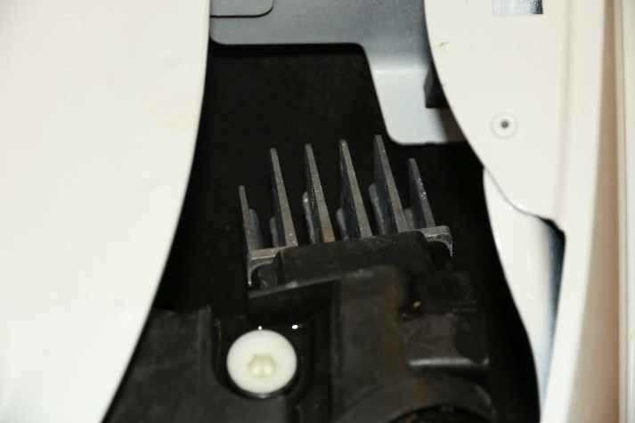
Harder images to predict its labels:
Scheinwerfer_
Blinker
Scheinwerfer_Blinker
Scheinwerfer_Blinker

Slide 11
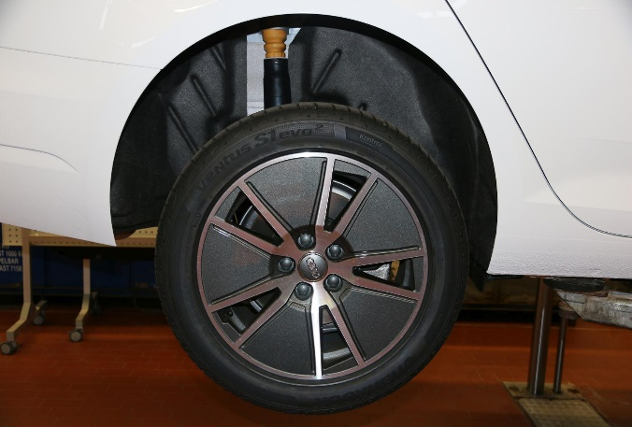
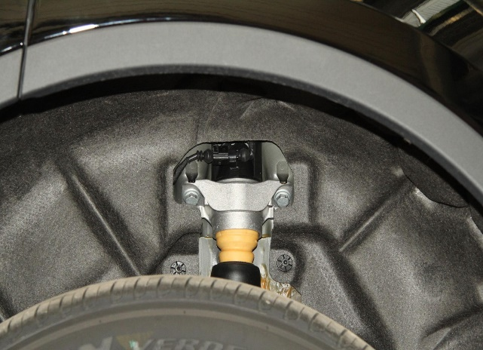
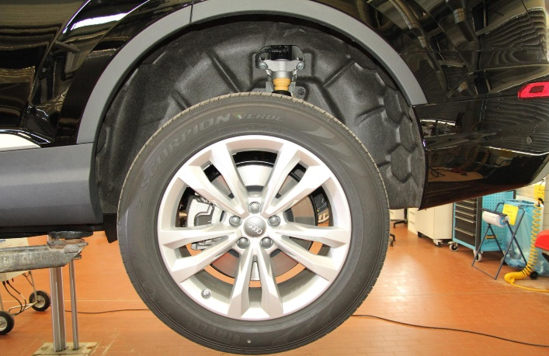
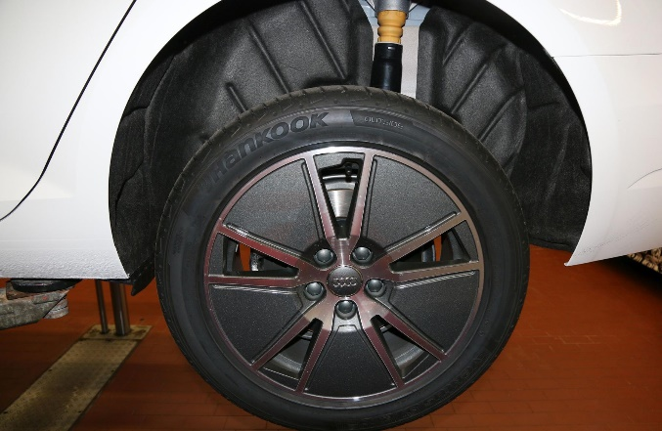
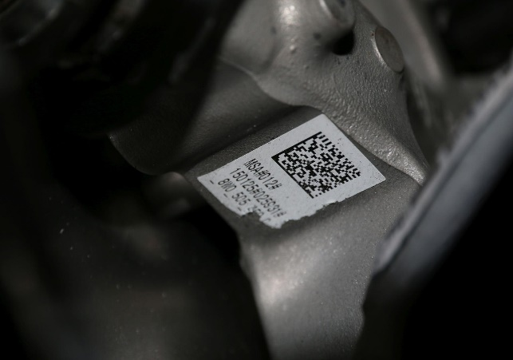
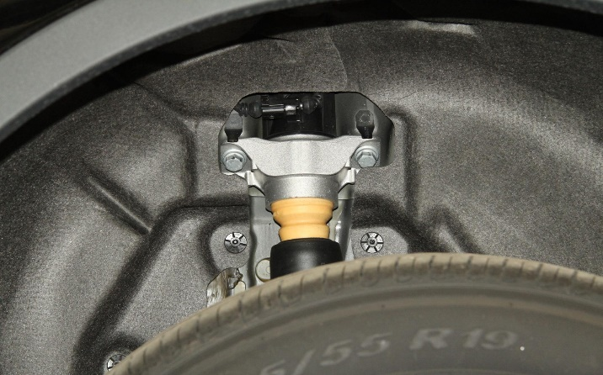
Sample data- HA (Messy)

Slide 12

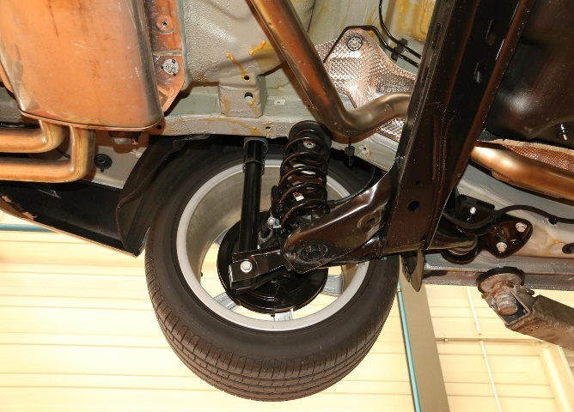


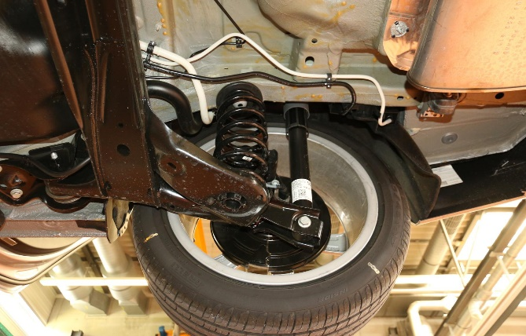
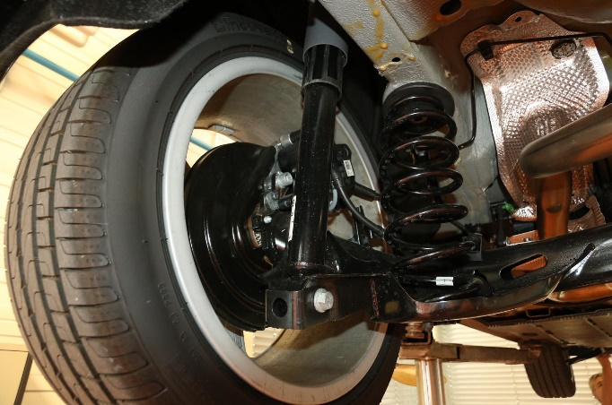
Data-HA Category (Clean)

Slide 13
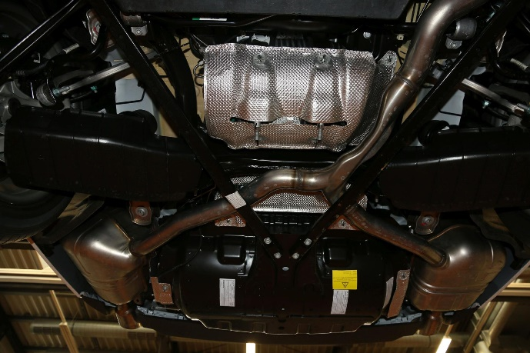

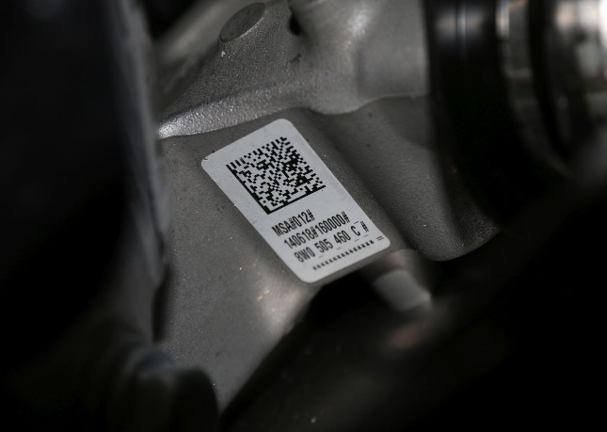
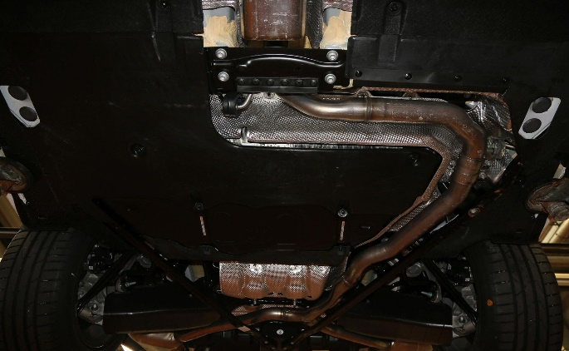
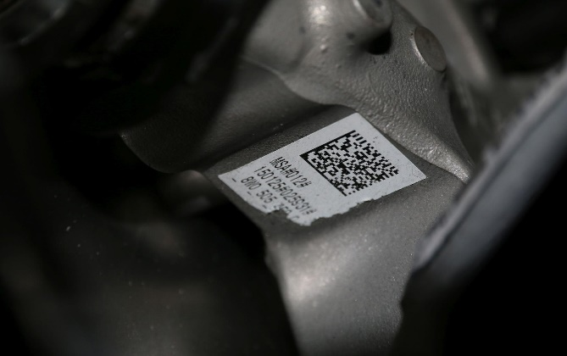
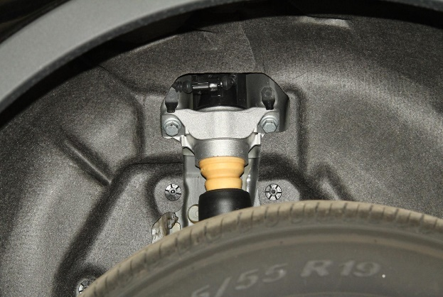
Data-HA Category (Harder Images)

Slide 14
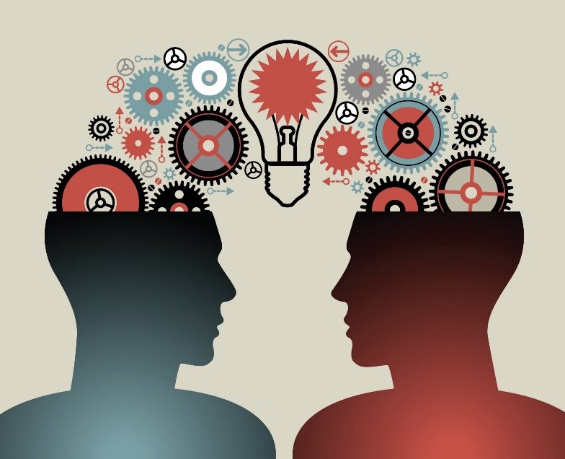
Transfer Learning
When we have a small dataset or a very low number of good images then we better to use transfer learning approach.
In this transfer learning approach, several pre-trained models are trained for best accuracy on Imagenet database.
Pre-trained Nets:
Resnet, alexnet, densenet, inception etc

Slide 15
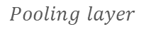
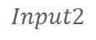
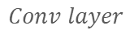
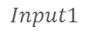
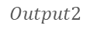
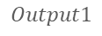
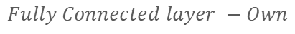
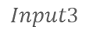
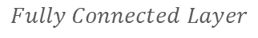
Pre-Trained Nets
$$Pooling layer$$
$$Fully Connected Layer$$
$$Conv layer$$
$$Input1$$
$$Fully Connected layer −Own$$
$$Output1$$
$$Input2$$
$$Output2$$
$$Input3$$

Slide 16






Progress of my Master thesis.
Basic research about deep learning frameworks and some pretrained nets.
Data visualization and analysis
Minimal training on Resnet on about 20 categories
Full length training and hyperparameter tuning
Future modifications and improvements
Thesis writing and submission

Slide 17





Tools used:
Deep learning
Framework
Python
Ubuntu 16.04
VS Code
Anaconda
And other python small scripts for data visualization…

Slide 18
Vielen Dank für Ihre Aufmerksamkeit!

